Slide 1
CS 4530: Fundamentals of Software Engineering Midterm Review
Jonathan Bell, Adeel Bhutta, Mitch Wand
Khoury College of Computer Sciences
WARNING: Please note that students are responsible for all content covered in class so far. These slides are a quick review of some (but not all) of those topics. Feel free to use them as a starting point for your study/exam preparation.
© 2022 Released under the CC BY-SA license

Slide 2
Logistics for midterm (from Piazza)
The exam will be proctored online through Canvas. There will be no Respondus/Lockdown browser scheme.
Questions on the exam will draw from the learning objectives that are included in each of the lessons.
We suggest reviewing the learning objectives in the first slide of each lesson, which describe what we hope you to learn from that lesson. The learning objectives explicitly use Bloom’s Taxonomy action verbs - some simply expect you to learn to remember some facts, and others expect you to be able to understand, apply and/or evaluate them.
The questions will be a mix of multiple choice and open-ended questions
Some questions may ask you to read code written in TypeScript and explain what it does/why it does that; no questions will require you to write code in TypeScript
The exam will be 90 minutes long and will be scheduled for Wednesday (Section 3), Thursday (Section 2, 5) and Friday (Section 4) next week.
If you have DRC accommodation, please reach out to your instructor as soon as possible.

Slide 3
Module 1: Requirements Gathering
At the end of this lesson, you should be able to
Explain the overall purposes of requirements analysis
Enumerate and explain 3 major dimensions of risk in Requirements Analysis
Explain the difference between functional and non-functional requirements, and give examples of each
Explain the notion of a user story, with examples. (including conditions of satisfaction)
Notes:
<read slide>

Slide 4
Module 2: Test-Driven Design
At the end of this lesson, you should be prepared to
Explain the basics of the Test-Driven Design
Develop simple applications using Typescript and Jest
Learn more about Typescript and Jest from tutorials, blog posts, and documentation
Notes:
<read slide>

Slide 5
The TDD Cycle
Analyze
Design
Code
Satisfaction Conditions
Testable Behaviors
Executable Tests
Executing Code
Notes:
This depiction of the TDD cycle may be a little different from what you’ve seen before.
To see what all this means, we’ll work through a small example. Along the way, we’ll learn a little Typescript and a little Jest, just enough to do the example.
We start with the user’s satisfaction conditions. We refine those to come up with testable behaviors– concrete, testable things that our system should do. Along the way, we may discover some design decisions that we need to make.
Our next step is to turn these testable behaviors into executable tests. To do this, we will need to design some of our program– at the very least, we will have to decide on the names of the things we will test.
Finally, we write some code that will pass our tests.
Or not so finally– we do this one test (or a few tests) at a time. Once we get our code to pass one test, we go back and get the next test to work. If there are no more tests, we go back to the next unsatisfied testable behavior. And if we have no more testable behaviors, we go back and start on the next satisfaction condition.

Slide 6
Module 3: Code-Level Design Principles
By the end of this lesson you should be able to:
Describe the purpose of our design principles
List 5 code-level design principles with examples
Identify some violations of the principles and suggest ways to mitigate them
Notes:
<Read Slide>

Slide 7
Five general-purpose design principles
Five General Principles
1. Use Good Names
2. Make Your Data Mean Something
3. One Method/One Job
4. Don't Repeat Yourself
5. Don't Hardcode Things That Are Likely To Change
Notes:
Here are five general-purpose principles that apply to just about all programming tasks. We’ve phrased this in terms of programming practices: things that you can do to make your code better.
I suggest that you make a sticky note with this list and keep it on your laptop screen or somewhere in your workspace so that you will be constantly reminded of it.

Slide 8
Module 4: Interaction-Level Design Patterns
By the end of this lesson, you should be able to
Explain how patterns capture common solutions and tradeoffs for recurring problems.
Give 4 examples of interaction patterns and describe their distinguishing characteristics
Draw a picture or give an example to illustrate each one
Notes:
<read slide>

Slide 9
The Interaction Scale: Examples
The Pull pattern
The Push pattern (aka the Observer* Pattern or Listener Pattern)
The Factory* Pattern
The Singleton Pattern* (aka the Lying Factory)
*These are “official Design Patterns” that you will see in Design Patterns Books
Notes:
In this lesson, we will study 4 different interaction-scale designs: the pull pattern (which is so simple it hardly counts as a pattern), the push (or Observer or Listener) Pattern, the Factory Pattern, and the Singleton Pattern.
All but the first of these are “Official Design Patterns” that you will see in Design Patterns Books, and they have standard names. That’s important, because if you need to tell your teammate about what you’ve done in a certain part of your program, you can say “for such-and-such, we use the Observer Pattern”, and then your teammate will know what you mean, because they know what the phrase “Observer Pattern” means. This is what we mean when we talk about using a shared vocabulary.
We may use many different Interaction-scale designs for different portions of our program.

Slide 10
Module 5: Concurrency Patterns in Typescipt
At the end of this lesson, you should be prepared to:
Explain how to achieve concurrency through asynchronous operations and Promise.all in TypeScript.
Write asynchronous and concurrent code in TypeScript using async/await and Promise.all.
Notes:
<read slide>

Slide 11
Leverage Concurrency When Possible
The code we’ve seen on past slides:
Where you place awaits can make a big difference!
For each student: make an async handler to fetch their transcript and save it
async function runClientAsync() {
console.log('Making a requests');
const studentIDs = [1, 2, 3, 4];
const promisesForTranscripts = studentIDs.map(
async (studentID) => {
const response = await axios.get(`https://rest-example.covey.town/transcripts/${studentID}`)
await fsPromises.writeFile(`transcript-${response.data.student.studentID}.json`, JSON.stringify(response.data))
});
console.log('Requests sent!');
await Promise.all(promisesForTranscripts);
const stats = await Promise.all(studentIDs.map(studentID => fsPromises.stat(`transcript-${studentID}.json`)));
const totalSize = stats.reduce((runningTotal, val) => runningTotal + val.size, 0);
console.log(`Finished calculating size: ${totalSize}`);
}
Running time:
1.5 sec
For each student: wait to fetch their transcript, then wait to write it, then go on to the next student
This accomplishes the same function, but without concurrency:
async function runClientAsyncSerially() {
console.log('Making a requests');
const studentIDs = [1, 2, 3, 4];
for(let studentID of studentIDs){
const response = await axios.get(`https://rest-example.covey.town/transcripts/${studentID}`);
await fsPromises.writeFile(`transcript-${response.data.student.studentID}.json`, JSON.stringify(response.data))
}
let totalSize = 0;
for(let studentID of studentIDs){
const stats = await fsPromises.stat(`transcript-${studentID}.json`);
totalSize += stats.size;
}
console.log(`Finished calculating size: ${totalSize}`);
}
Running time:
2.2 sec
This is what we mean by “your code can become synchronous”
Notes:
Why is that concurrency important?
Here’s another implementation of those same tasks, which is functionally equivalent. But, there is a subtle difference in how they run.
(Build) In the code that we built up on the past slides, we create an async task for each student to fetch the transcript.
(Build) In the code on the bottom, we have a single handler. It gets the first student’s transcript. THEN it gets the second, THEN the third, etc. This prevents concurrency: can’t fetch multiple things at once. Same story for the rest of the code – checking the size of each JSON file
(Build) The bottom implementation is 1.5x slower. Again, these are small numbers here with just 4 student IDs, but if you had hundreds or thousands, you would see a tremendous performance difference.
Hence, our reminder and lesson is to leverage concurrency when possible. If you have multiple things that could happen at once, await them all by using Promise.all. This pattern of taking an array of stuff and ‘map’ing it to promises is extremely common and valuable – you should write this down.

Slide 12
Run-to-completion semantics
A computation runs continuously until it is either suspended or completed.
This means that only one of your computations is running at any time (in addition to whatever asynchronous IO is running)
A computation is suspended when it hits an ‘await’. The runtime system (node.js, for us) chooses what to do next. (In addition to whatever asynchronous IO it may be doing).

Slide 13
Module 6.1: Software Processes
At the end of this lesson, you should be able to
Know the basic characteristics of the waterfall software process model
Be able to explain when the waterfall model is appropriate and when it is not
Understand how the waterfall and agile models manage risk
Be able to explain how agile process instill quality, including through test driven development
Notes:
<read slide>

Slide 14
Module 6.2: Agile Planning and Estimation
At the end of this lesson, you should be able to
Describe how agile planning manages uncertainty by creating detailed plans only for the most immediate tasks
Explain how agile planning decomposes large projects into individual tasks that can be estimated
Understand the key artifacts and process steps in Scrum
Notes:
<read slide>

Slide 15
Module 6.3: Teams
At the end of this lesson, you should be able to
Explain key advantages of working in a team and sharing information with your team
Describe the HRT pillars of social interaction
Understand why agile processes favor small teams
Apply root-cause analysis to construct a blameless post-mortem of a team project
Notes:
<read slide>

Slide 16

Lesson from Meteorology: Uncertainty in Estimation
Notes:
In some ways, predicting how long it will take to build some software project is like predicting the path of a hurricane: With state-of-the-art computer models, we can predict with reasonable certainty where the center of a hurricane will move to over the coming hours. If you have lived in an area that is subject to hurricanes, you may be familiar with maps like this. This hurricane track map shows a “cone of uncertainty” of where the center of the storm will move to.
This map was generated by the NWS National Hurricane Center at 10pm on Saturday Aug 28, 2021. You can see that for the next 48 hours it’s pretty clear which direction it’s going, and the size of the track is quite narrow. As time progresses, the quality of the estimate decreases, and the cone gets wider. Ultimately for days 4-5, the cone is shown with a different texture to make clear that this prediction is even less precise. The map even comes with a disclosure that it is only predicting the CENTER of the storm’s path, and not the scope of the impact.
It is hard to estimate exactly where a software project will be after a few months, but like a hurricane model, as we get more data, our estimates can improve in quality.

Slide 17
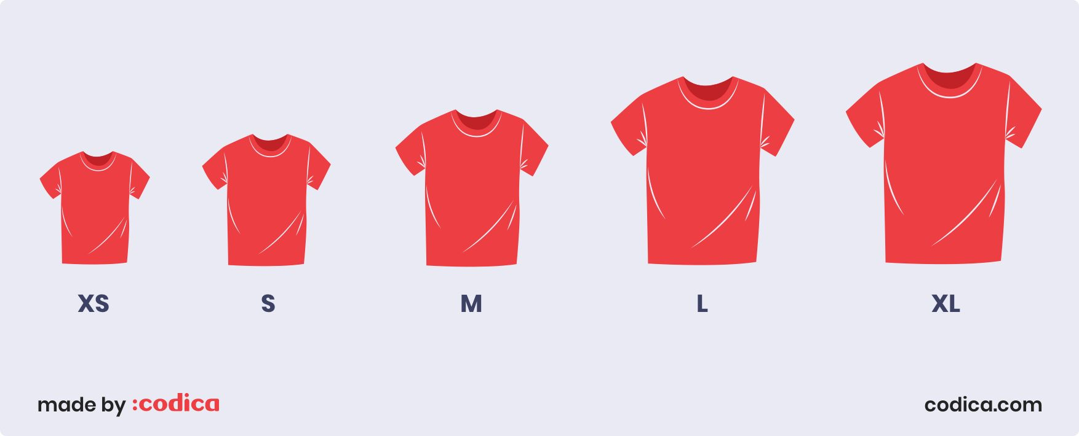
Estimating with T-Shirt Sizes
Notes:
XS are things we really know how to do quite quickly
S are a bit bigger. We’ve done this exact task before, it takes more than a few minutes, but we know it can be done with ease
M – maybe things we have experience with, but not that exact task.
L– challenging task that will need investigation.
XL – huge amount of work and complexity.
What we like about t-shirt sizes is that they are relative: we define how hard something will be based on what we’ve done before. We also like that they do not directly imply time estimates, because the time estimates are likely to be under-estimates anyway.

Slide 18
Module 6.3: Teams
At the end of this lesson, you should be able to
Explain key advantages of working in a team and sharing information with your team
Describe the HRT pillars of social interaction
Understand why agile processes favor small teams
Apply root-cause analysis to construct a blameless post-mortem of a team project
Notes:
<read slide>

Slide 19
What goes wrong with teams in software development?
How do you structure teams effectively?
How do you encourage team-members to treat each other well?
How do you encourage teams to share knowledge and collaborate?
How do you respond to failures?
Notes:
[Ask students to share experiences good and bad of working in teams before doing animation]
(Read slide of common team issues)
Our goal with this lesson is to share some common strategies to address these problems. Some of these lessons will be things that you can operationalize: how to be a better team player. Others will be things that you won’t be able to operationalize directly. We do not expect many of you will graduate and immediately enter positions where you will be making decisions about how to structure and lead a team. But, it is quite likely that you will be subject to someone else making those decisions. Through this lesson, we hope to provide you with a framework for understanding how effective teams are organized. One of the core agile principles that we’ve been talking about this week is: how to connect what we are doing to the ultimate value that we are delivering to our customers through our software. By understanding why team processes are setup like they are, hopefully you can understand better the value that those processes provide – and maybe you can even help your manager reflect on and improve their existing processes.

Slide 20
Three Pillars of Social Skills
Pillar 1: Humility: You are not the center of the universe (nor is your code!). You’re neither omniscient nor infallible. You’re open to self-improvement.
Pillar 2: Respect: You genuinely care about others you work with. You treat them kindly and appreciate their abilities and accomplishments.
Pillar 3: Trust: You believe others are competent and will do the right thing, and you’re OK with letting them drive when appropriate.
From “Debugging Teams” by Ben Collins-Sussman and Brian Fitzpatrick
Notes:
If we agree that there are no 10x engineers, and that we need to form effective teams in order to scale up our software engineering processes, then perhaps we can agree on some ground-rules for working productively with our team mates. These three pillars are taken from the book “Debugging Teams” - the authors of this book are long-time software team leads at Google.
Both trace almost every social conflict that they have witnessed in their orgs back to a lack of one of these three traits.
This lens (HRT, pronounced “heart”) is useful for evaluating all kinds of personal conflicts. We work with others, and will be most effective when we can create long-lasting relationships with our colleagues who will be able to help us out later when we need. For example: nobody wants to work with someone who consistently behaves like they are the smartest person in the room. Give and receive constructive criticism.
(some notes on pillars)
Humility – it’s fun to be the most knowledgeable person in the room, and mentoring others can be rewarding. It is easy to get addicted to being the lead on projects – you start out as the person who knows the most about something. But, eventually you will need to change directions and get exposed to new things. Once you reach a local maximum on your team, you stop learning. And then you get bored. Put yourself outside of your comfort zone, and be open to trying new things that you are less confident about. Be willing to show some weakness.
Respect – how do you criticize and give feedback on someone’s work while recognizing their strengths?
Trust – Might feel hard at first if you have been burned many times by team-mates who you delegated something to and who were, simply put, incompetent. Requires a two-way commitment. Trust that you can delegate something to someone else, and that they will have the respect and humility to ask for help if needed.

Slide 21
Module 7: REACT Basics
By the end of this lesson, you should be able to:
Understand how the React framework binds data (and changes to it) to a UI
Create simple React components that use state and properties
Be able to map the three core steps of a test (construct, act, check) to UI component testing

Slide 22
Hello World in React
export function HelloMessage(){
return <div>Hello, World!</div>
}
“Declare a Hello component”
“Return the following HTML whenever the component is rendered”
Declares a new component that can be rendered by React
The HTML is dynamically generated by the library.
function App(){
return <HelloMessage />;
}
“Render a Hello Component”
Components are rendered as if they were HTML tags
Notes:
This code snippet shows a React component called HelloMessage.
In typescript, a component is declared by defining a function which must start with a capital letter.
Every component must return some html, and in this case, we return “Hello World”.
This component contains no logic or data and is a static component which will return the same html every time.
To render a component, we reference it as if it were an HTML tag, as underlined in red.
The “root.render’ bit occurs just once in our react app - we render some component as the “root”, and then as we will see, that component can include others.

Slide 23
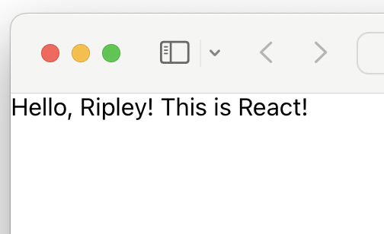
React Components Can Receive Properties
Properties are passed in an argument to the component
Properties are specified as attributes when the component is instantiated
Properties can not be changed by the component
Reminder: inside of HTML code, execute TypeScript code using {mustaches}
export function PersonalizedHello(props: {name: string}){
return <div>Hello, {props.name}! This is React!</div>
}
<PersonalizedHello name="Ripley" />
Notes:
(Read slide)
The screenshot on the right shows what appears in the browser when this code renders.
It is difficult to imagine how we can construct rich, dynamic web applications using just components with properties: since properties can’t be changed, it is difficult to have dynamic behavior.
In React, we call data that can change: “state”

Slide 24
Component State is Data That Changes
All internal component data that, when changed, should trigger UI update
Stored as state variables in the component
Created using useState<stateType>(defaultValue)
E.g. const [isLiked, setIsLiked] = useState(false);
Import useState from React
The only way to change the value of a state variable is with the setter
You could choose any names for the variable and its setter; for this class, please follow the convention of const [goodVariableName, setGoodVariableName]
Notes:
“State” is component data that changes. It is important to distinguish data that doesn’t change from data that does change because changes to data should result in the component re-rendering. That is, when the data changes, we want our component to “react” to the change visually.
With React, we define state variables by calling this special method “useState”. useState takes a single parameter, which defines the default value of the state.
useState returns an array with two elements: the first element is the value of the state variable, and the second is a setter which is used to change the state variable - the code on line 2 is typescript shorthand for saying: “declare a variable isLiked, and set it to the first element of the array returned by useState, and declare another variable setIsLiked, and set it to the second element in that array”
All other updates to state must be made through the setter function.
React doesn’t care what names you choose for these variables; however for this class, we care that you choose a good variable name (as covered in our general design principles), and call the setter “setGoodVariableName”

Slide 25
useState Tracks Mutable State
const [state, setState] = useState<TypeOfState>(initialValue);
useState returns an array of length 2: the first value is the current state value, second is a setter we can call to update that value. React doesn’t know or care what names you choose here (var, setVar are convention though!)
<TypeOfState> is an optional generic type parameter to declare the type of state
initialValue is the value that state should take before the first call to setState
export function LikeButton(){
const [isLiked, setIsLiked] = useState(false);
if (isLiked) {
return (<IconButton aria-label="unlike"
icon={<AiFillHeart />} onClick={() => setIsLiked(false)} /> );
} else {
return (<IconButton aria-label="like"
icon={<AiOutlineHeart />} onClick={() => setIsLiked(true)} /> );
}
}
Notes:
(Read the signature of setState and the captions explaining the return, type, and initial value). Note that the syntax [state, setState] = useState is shorthand syntax that means “take the first element in the array returned by useState and assign it to state, and the second, assign that to setState” - this is not specific to useState, and you can use this syntax elsewhere.
With this more clear definition of useState, let’s revisit how to store and update the state of our “like” button. We declare our state variable isLiked, and the setter for it. The initial value for the button is “false” - not liked. In a slightly more realistic example, we might initialize the state of the button to match something that is stored on some server or database. When we provide an initial value for the state, we can let typescript automatically infer the type of the state variable (to be the same as the type of the initial value) - that’s why in this example we don’t declare that isLiked is a “boolean” (cool!)

Slide 26
State Setters are Asynchronous
Recall from Module 7: React uses a carefully optimized approach to (re)-render components
Components are not re-rendered immediately upon calling a state setter
export function LikeButton(){
const [isLiked, setIsLiked] = useState(false);
const [count, setCount] = useState(0);
if (isLiked) {
...
} else {
return (<IconButton aria-label="like" icon={<AiOutlineHeart />} onClick={() => {
console.log(`Pre-setCount, count=${count}`)
setCount(count + 1)
setIsLiked(true)
console.log(`Post-setCount, count=${count}`)
}} /> );
}
}
Output:
(Click like) 1. Pre-setCount, count=0 2. Post-setCount, count=0
Notes:
(Read top 2 bullets)
For reasons that are very related to the “run-to-completion” semantics of javascript, component re-renders are batched together and performed asynchronously.
We’ve annotated the like button example with some console.log statements to illustrate this behavior.
(Click to show output)
When this component is rendered the first time, it will show “Likebutton rendered isLiked=false”. Upon clicking on the “like” button, we’ll see the call to setIsLiked, then the return from setIsLiked, but the isLiked variable has not yet been updated.
Shortly after, React will re-render the component (calling this function again), printing out the message “LikebuttonRendered isLiked=true”.
The key implication of “state setters are asynchronous” is that your component’s logic should not assume that the state variable is set immediately - if you have some logic that should occur as a *side effect* of the state variable being updated, then this is best performed using a different hook - useEffect

Slide 27
Inspecting Rendered Components: ARIA label
if (isLiked) {
likeButton = (<IconButton aria-label="unlike"
icon={<AiFillHeart />} onClick={() => setIsLiked(false)} /> );
} else {
likeButton = (<IconButton aria-label="like"
icon={<AiOutlineHeart />} onClick={() => setIsLiked(true)} /> );
}
SUT
test("Like button defaults to not liked, clicking it likes, clicking again unlikes", () => {
const likeButton = screen.getByLabelText("like");
fireEvent.click(likeButton);
const unLikeButton = screen.getByLabelText("unlike");
fireEvent.click(unLikeButton);
expect(screen.getByLabelText("like")).toBeInTheDocument();
});
Test
Notes:
How do we find and interact with the like button? Another strategy for finding rendered components is to use the “aria label” – making use of that alt text that we specified on the buttons.
This test will find the like button (or throw an error if it can’t be found), then click the button, then find the unlike button (or throw an error if it doesn’t’ exist), and then click it. At the end, it will one last time find the like button, and click it. We could be even more verbose and assert that the OTHER button isn’t there too, but that would be a very verbose test…

Slide 28
Module 8: useState and useEffect
By the end of this lesson, you should be able to:
Recognize and apply four common patterns in functional React components (useState, useEffect, useCustomHook, useContext)
Understand how React functional components allow behaviors to be reused

Slide 29
useState Tracks Mutable State
const [state, setState] = useState<TypeOfState>(initialValue);
useState returns an array of length 2: the first value is the current state value, second is a setter we can call to update that value. React doesn’t know or care what names you choose here (var, setVar are convention though!)
<TypeOfState> is an optional generic type parameter to declare the type of state
initialValue is the value that state should take before the first call to setState
export function LikeButton(){
const [isLiked, setIsLiked] = useState(false);
if (isLiked) {
return (<IconButton aria-label="unlike"
icon={<AiFillHeart />} onClick={() => setIsLiked(false)} /> );
} else {
return (<IconButton aria-label="like"
icon={<AiOutlineHeart />} onClick={() => setIsLiked(true)} /> );
}
}
Notes:
(Read the signature of setState and the captions explaining the return, type, and initial value). Note that the syntax [state, setState] = useState is shorthand syntax that means “take the first element in the array returned by useState and assign it to state, and the second, assign that to setState” - this is not specific to useState, and you can use this syntax elsewhere.
With this more clear definition of useState, let’s revisit how to store and update the state of our “like” button. We declare our state variable isLiked, and the setter for it. The initial value for the button is “false” - not liked. In a slightly more realistic example, we might initialize the state of the button to match something that is stored on some server or database. When we provide an initial value for the state, we can let typescript automatically infer the type of the state variable (to be the same as the type of the initial value) - that’s why in this example we don’t declare that isLiked is a “boolean” (cool!)

Slide 30
State Setters are Asynchronous
Recall from Module 7: React uses a carefully optimized approach to (re)-render components
Components are not re-rendered immediately upon calling a state setter
export function LikeButton(){
const [isLiked, setIsLiked] = useState(false);
const [count, setCount] = useState(0);
if (isLiked) {
...
} else {
return (<IconButton aria-label="like" icon={<AiOutlineHeart />} onClick={() => {
console.log(`Pre-setCount, count=${count}`)
setCount(count + 1)
setIsLiked(true)
console.log(`Post-setCount, count=${count}`)
}} /> );
}
}
Output:
(Click like) 1. Pre-setCount, count=0 2. Post-setCount, count=0
Notes:
(Read top 2 bullets)
For reasons that are very related to the “run-to-completion” semantics of javascript, component re-renders are batched together and performed asynchronously.
We’ve annotated the like button example with some console.log statements to illustrate this behavior.
(Click to show output)
When this component is rendered the first time, it will show “Likebutton rendered isLiked=false”. Upon clicking on the “like” button, we’ll see the call to setIsLiked, then the return from setIsLiked, but the isLiked variable has not yet been updated.
Shortly after, React will re-render the component (calling this function again), printing out the message “LikebuttonRendered isLiked=true”.
The key implication of “state setters are asynchronous” is that your component’s logic should not assume that the state variable is set immediately - if you have some logic that should occur as a *side effect* of the state variable being updated, then this is best performed using a different hook - useEffect

Slide 31
Pattern: useEffect Invokes Side-Effects after rendering
Context: React components are just functions, called on each render.
Problem: How to define side-effects that run in response to data changing (and in turn, the component re-rendering)?
Pattern: React’s useEffect hook
useEffect(()=>{
// Code that runs after each render
return () => {
// Code that runs after the component is removed from the page OR before hook runs again
}
})
Notes:
If we would like to invoke some side effect after a component renders with React, we use the “useEffect” hook. “useEffect” solve the common problem of defining side-effects that run in response to data changing (and in turn, re-rendering).
useEffect is a function provided by React that takes, as a parameter, a callback function. That callback function is invoked each time that the component re-renders.
The function passed to useEffect can (optionally) return another function, which is called to cleanup any side-effects that the useEffect might have performed, like creating event listeners that should be removed.

Slide 32
useEffect Dependencies Limit Their Execution
useEffect takes an optional array of dependencies
The effect is only executed if the values in the dependency array change (by reference equality)
useEffect(()=>{
// Code that runs after each render
return () => {
// Code that runs after the component is removed from the page OR before hook runs again
}
})
useEffect(()=>{
// Code that runs after each render if dependency or anotherDependency change
return () => {
// Code that runs after the component is removed from the page OR before hook runs again
}
}, [dependency, anotherDependency])
Only run the effect if dependency or anotherDependency change to point to a different thing
useEffect(()=>{
// Code that runs after each render if dependency or anotherDependency change
}, [])
Only run the effect on the very first render
Notes:
The useEffect hook also takes an array of dependencies. If an array is provided, then React will only call our effect if any of the values in that dependency array change. React uses simple reference equality to check for changes - so changing an object property on one of those dependencies won’t trigger an execution; pushing elements into an array won’t trigger it either. This will only be triggered if the variable `dependency` or `anotherDependency` point to something new than they did on a prior render.
(Click) As a special case, passing an empty dependency array means that the side-effect should run only on the very first render (and cleanup only when the component is removed from the page)

Slide 33
Module 9: Distributed Systems Principles
Describe 5 key goals of distributed systems
Understand the fundamental constraints of distributed systems
Understand the roles of replication and partitioning in the context of the DNS infrastructure

Slide 34
Distributed Systems Goals
Scalability
Performance
Latency
Availability
Fault Tolerance

Slide 35



Recurring Solution #1: Partitioning
Divide data up in some (hopefully logical) way
Makes it easier to process data concurrently (cheaper reads)
Each server has 50% of data, limits amount of processing per server.
Even if 1 server goes down, still have 50% of the data online.
A
[0…100]
B [A…N]
A
[101.. 200]
B [O…Z]
Notes:
With partitioning, we divide up data in some (hopefully logical) way. Deciding how to split this data into partitions can be a tricky problem. One easy way to do this is to use some property of the data: if we have 200 records, and they are indexed from 0… 200, you could envision putting the first 100 on one server, and the next 200 on another. Or, split student records by last name: A..N on one server and O..Z on another.
This can improve scalability because we can now process more requests concurrently: each server holds some subset of our data, and if clients want to touch different pieces of that dataset, they can interact with different machines. Even if one server goes down, the rest of the data would still be available.

Slide 36
Recurring Solution #2: Replication
Entire data set is copied
A
B
A
B
Notes:
And replicate it to multiple servers. In this model, our entire service (and all of the data) is replicated across multiple servers. Ideally, either server can process any request. Hence, we can increase the fault tolerance and performance of our system by having multiple machines that can process requests concurrently, and if one fails, the other can continue to process requests. We can even use this scheme to reduce latency, by placing these replicas in geographically diverse areas. If our replica is physically closer to a client, then it will take less time for a request to get to our server, and a response to get back to the client.

Slide 37
Partitioning + Replication
So, DNS combines both partitioning and replication
As do most distributed systems
A
A
B
B
Notes:
Of course, most distributed systems combine both partitioning and replication

Slide 38
Replication Problem: Consistency
We probably want our system to work like this
Set A=5
“OK”!
Read A
“5”!
A
B
A
B
6
5
7
6
5
7
Notes:
Replication introduces a new problem, which is: consistency.
Consistency means that all nodes in a replicated system see the same data at the same time. When we set A to 5, the 5 appears on all of the replicas at once.

Slide 39
What if the network fails?
Set A=5
“OK”!
Read A
“6”!
Set A=5
Assume replica failed
A
B
A
B
6
5
7
6
7
Notes:
However what if the connection between the updated node and the replica fails? This is an assumption that we need to keep (our system must tolerate network partition)
Here, we fail to share the updated state, timeout occurs, but the replica is still up and servicing requests.
If we still want to service requests, we assume the replica is down and continue, prioritizing availability and losing consistency.
We could prioritize consistency, but then we would have to stop servicing requests, losing availability.

Slide 40
CAP Theorem: Consistency or Availability
Pick two of three:
Consistency: All nodes see the same data at the same time (strong consistency)
Availability: Individual node failures do not prevent survivors from continuing to operate
Partition tolerance: The system continues to operate despite message loss (from network and/or node failure)
Can’t drop this for a DS - networks can always fail
Notes:
Emphasize: If we want strong consistency, we won’t be able to achieve the availability we might want

Slide 41
Module 10: Distributed Systems Architecture
By the end of this lesson, you should be able to…
Recognize common software architectures
Understand tradeoffs of scalability, performance, and fault tolerance between these architectures
Describe what makes web services RESTful, and implement a REST API

Slide 42
Monolithic Architectures Struggle to Scale
Challenges with NFS
Scalability - How to go from 10 to 100 to 1,000 clients?
Performance - How to access 100’s of GB of data concurrently?
Fault tolerance - What if server crashes?
Server
Client
Client
Client
Client
Client
Notes:
While the monolithic architecture of NFS is certainly applicable to many use-cases (it is very widely used!), there are limitations to this architecture.
To scale a monolith (like NFS), our single option is to replace our server with a bigger server. Eventually, we will reach a limit of the performance of a single server. By definition, the monolith has a single server, so to break this scaling barrier, we will need a new architecture.
Similarly, the performance of the monolith is limited by the performance of that single node and its network links. If, in this figure, we have 5 clients all trying to read 100GB files concurrently, they will be limited by the total throughput of this one server.
Lastly, we will be quite limited in terms of a fault tolerance story here. If the single server goes down, the whole system goes down.

Slide 43
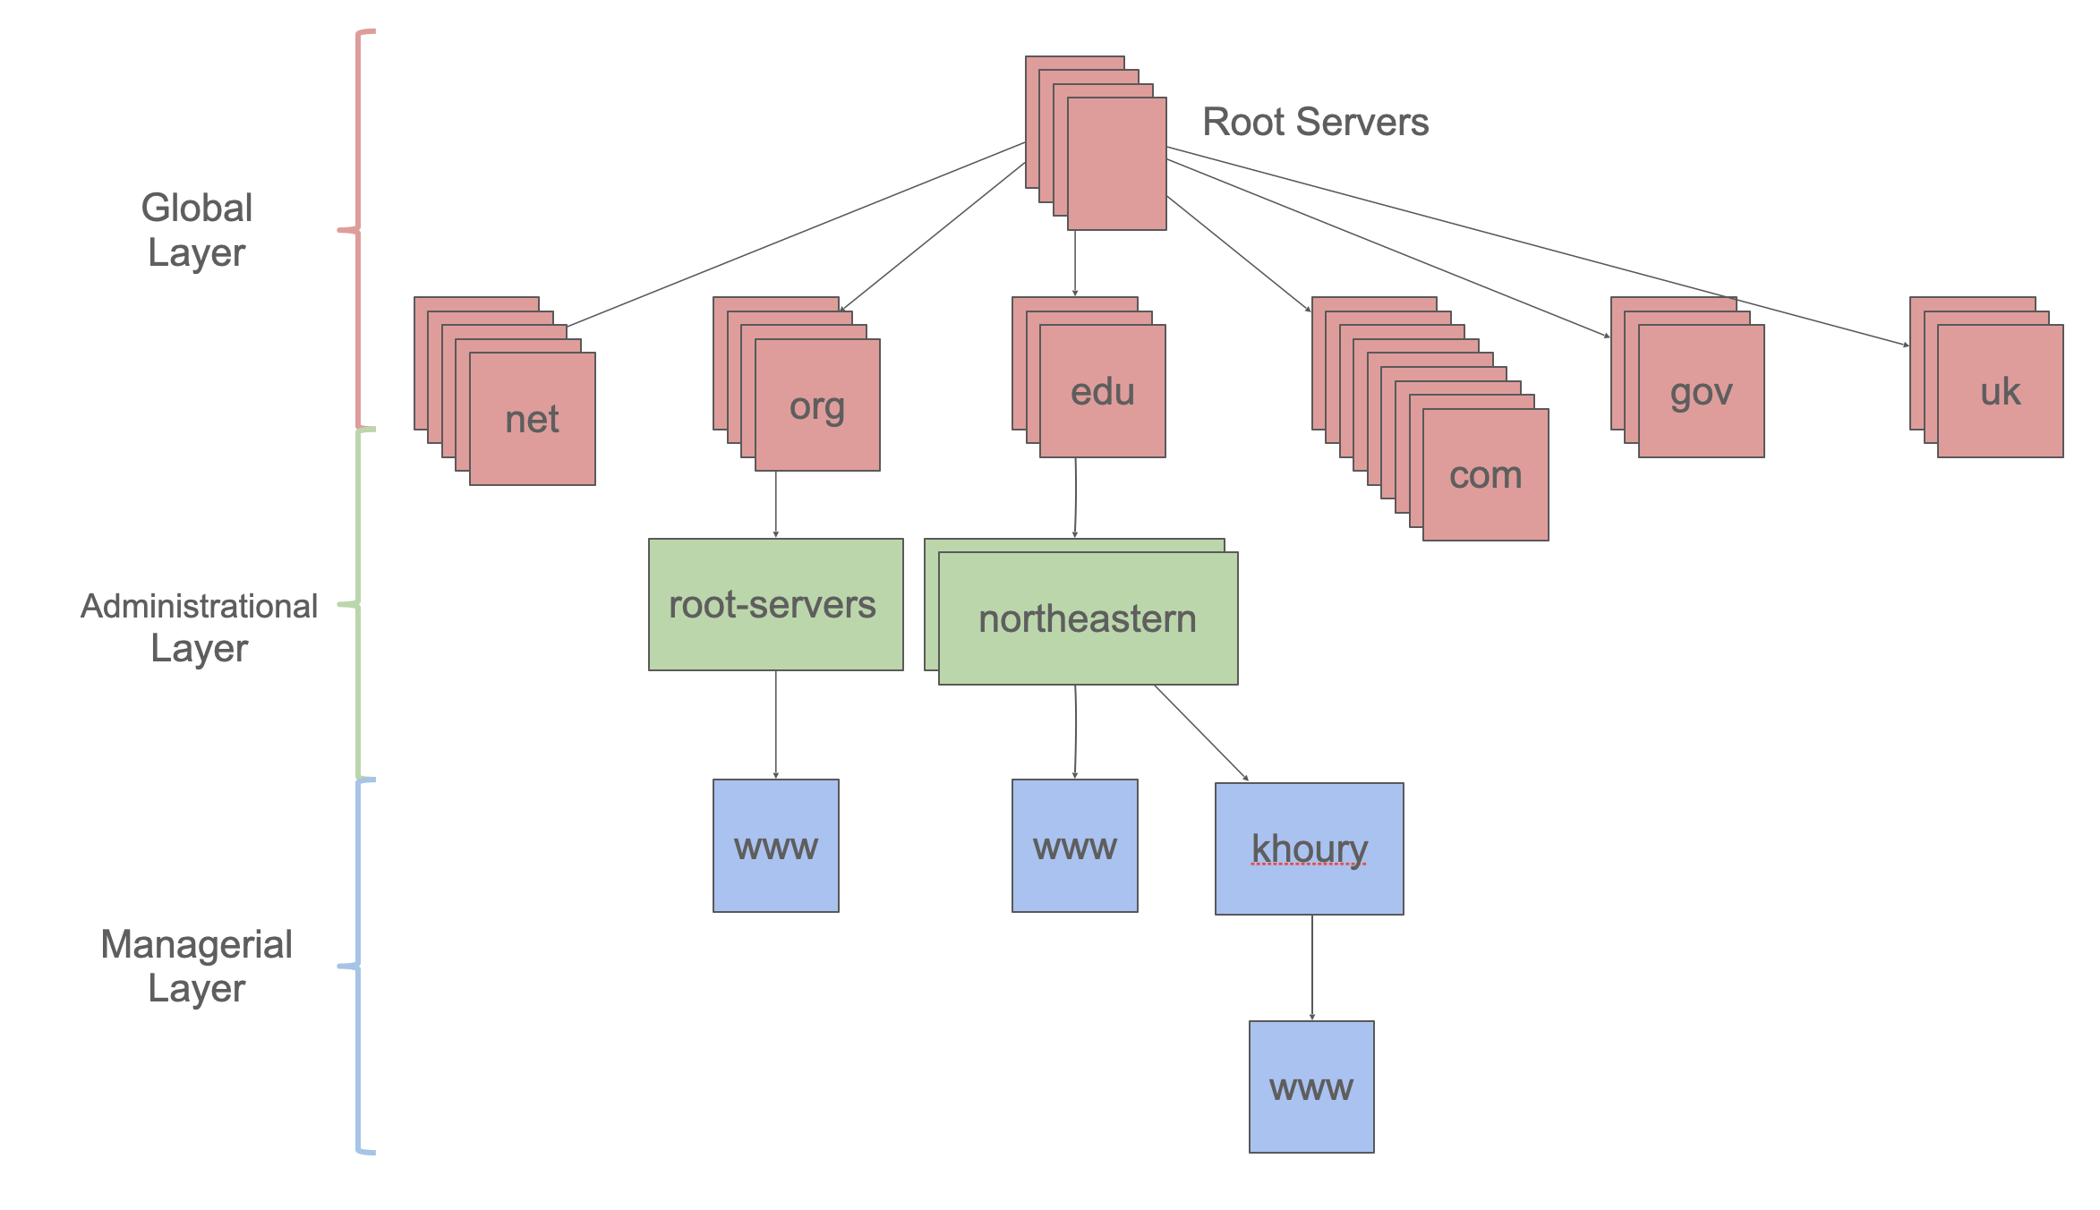
Tiered Architectures Partition Responsibility
Key idea: Partition the system into distinct tiers based on responsibilities
Each tier scales independently of the others - .com need not know about .org
Satisfying a single request may require multiple tiers
DNS is a tiered architecture
Notes:
DNS, which we discussed in the last module, is an example of what we call a “tiered” architecture.
(Read slide)

Slide 44
Pipeline Architectures
Scalability/Performance:
Add more machines to process more data in parallel
Limited by bandwidth to transfer inputs/outputs between stages
Fault tolerance: Each stage in pipeline is stateless. If one fails, it can be repeated elsewhere.
Big Data (lots of work)
Partition
Stage 1
Stage 1
Stage 1
Stage 1
Stage 1
Stage 2
Stage 2
Stage 2
Stage 2
Stage 2
Stage 3
Stage 3
Stage 3
Stage 3
Stage 3
Combine
Result
Notes:
How does a pipeline architecture address our distributed systems requirements and tradeoffs?
Similarly to the tiered architecture, we can scale to support processing more data concurrently by adding more machines. Each machine can process some number of stages concurrently. Because the stages are independent, we can always add more machines to process more data in parallel.
The limitation that we will run into is the bandwidth to transfer the inputs and outputs from each stage in the pipeline to the next.
However, once we recognize this limitation, we can also design systems around it: consider this exact problem of map/reduce running on a lot of data. How do we move that big amount of data to be in the right spot to run a task on it? Map/Reduce is implemented in conjunction with GFS: each filter in the pipeline is run on a chunk server that already has that piece of data.
In terms of fault tolerance, the pipeline architecture improves over the general tiered architecture because it also enforces the requirement that each stage in a pipeline is stateless. If a node fails in the middle of processing some data in a stage of the pipeline, the system could always recover by running that same input through the pipeline again: no data would become corrupted by partial results from the failed computation.

Slide 45
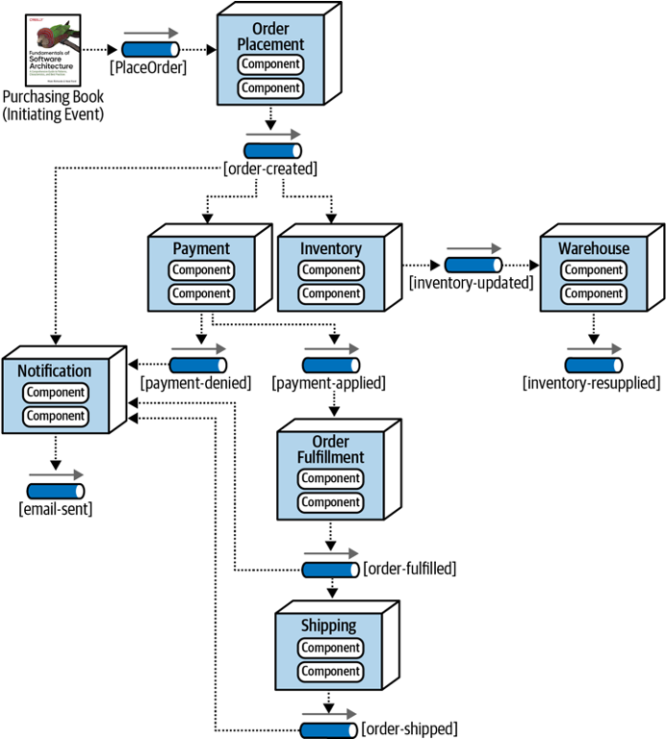
Event-Driven Architectures
Metaphor: a bunch of bureaucrats shuffling papers
Components correspond to stages in the flow of data through the system (not necessarily a straight-line flow)
Very useful for composing other services (bureaucrats)
Each processing unit has an in-box and one or more out-boxes
Each unit takes a task from its inbox, processes it, and puts the results in one or more outboxes.
Stages are typically connected by asynchronous message queues.
Notes:
(Read slide)

Slide 46

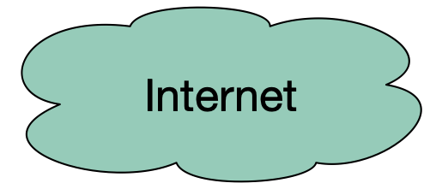
REST Principles
Single Server - As far as the client knows, there’s just one
Stateless - Each request contains enough information that a different server could process it (if there were multiple…)
Uniform Cacheability - Each request is identified as cacheable or not. (eg: GET is cacheable, POST is not!)
Uniform Interface - Standard way to specify interface
Clients
External Cache
Internal Cache
Web Servers
Client sees none of this!
Misc Services
App Servers
Database servers

Slide 47
Uniform Interface: Nouns are represented as URIs
In a RESTful system, the server is visualized as a store of resources (nouns), each of which has some data associated with it.
URIs represent these resources
Examples:
/cities/losangeles
/transcripts/00345/graduate (student 00345 has several transcripts in the system; this is the graduate one)
Anti-examples:
/getCity/losangeles
/getCitybyID/50654
/Cities.php?id=50654
We prefer plural nouns for toplevel resources, as you see here.
Useful heuristic: if you were keeping this data in a bunch of files, what would the directory structure look like?
But you don't have to actually keep the data in that way.

Slide 48
Uniform Interface: Verbs are represented as http methods
In REST, there are four things you can do with a resource
POST: requests the server to create a resource
there are several ways in which the value for the new resource can be transmitted (more In a minute)
GET: requests the server to respond with a representation of the resource
PUT: requests the server to replace the value of the resource by the given value
DELETE: requests the server to delete the resource

Slide 49
Module 11: Test Adequacy
By the end of this lesson, you should be able to:
Explain what makes a good test, and give examples and counter examples
Explain different things a test suite might accomplish, and sketch how one might judge how well a test suite accomplishes those goals
Notes:
We use testing to evaluate our software systems. This is captured in famous V&V terminology: Validation: Are we building the right product?
Verification: Are we building the product right?
Now, how do we evaluate testing itself? We will have to study two things: Purpose: Are tests checking the right things?
Adequacy: Are they checking the things right?

Slide 50
Mutation Analysis tests the Tests
Idea: What if many (real) bugs could be represented by a single, one-line “mutation” to the program?
public contains(location: PlayerLocation): boolean {
return (
location.x + PLAYER_SPRITE_WIDTH / 2 > this._x &&
location.x - PLAYER_SPRITE_WIDTH / 2 < this._x + this._width &&
location.y + PLAYER_SPRITE_HEIGHT / 2 > this._y &&
location.y - PLAYER_SPRITE_HEIGHT / 2 < this._y + this._height
);
}
Correct code for ‘Contains” in IP1
public contains(location: PlayerLocation): boolean {
return (
location.x + PLAYER_SPRITE_WIDTH / 2 < this._x &&
location.x - PLAYER_SPRITE_WIDTH / 2 < this._x + this._width &&
location.y + PLAYER_SPRITE_HEIGHT / 2 > this._y &&
location.y - PLAYER_SPRITE_HEIGHT / 2 < this._y + this._height
);
}
Mutated (and buggy) code for ‘Contains” in IP1
Notes:
Mutation analysis is an automated approach to evaluate how good tests are at detecting bugs.
The key idea is to create “mutations” - variants of the code that are likely to be buggy. Then, we could determine whether our test suite detects these “mutants” as a proxy for detecting bugs that we might make.

Slide 51
Mutation Analysis tests the Tests
Automatically mutates SUT to create mutants, each a single change to the code
Runs each test on each mutant, until finding that a mutant is detected by a test
Can be a time-consuming process to run, but fully automated
State-of-the-art mutation analysis tools:
Pit (JVM)
Stryker (JS/TS, C#, Scala)
Notes:
(We will use stryker in today’s activity)

Slide 52
Module 12: Designing Tests for Large Systems
By the end of this lesson you should be able to:
Explain why you might need a “test double” in your testing
Understand how and when to apply different kinds of test doubles, such as spies and mocks.

Slide 53
What are Test Doubles?
Test Double
Test Double
Business Logic
Network
Resources
Mo
Test Double
Random user
Mock network
Database
Fake Database
Notes:
Doubles are things that look like the real thing but they are not real.
If you are working on a system which sends an email to customer after an operation, how will you test it? Instead of sending a real email every time you test, you can use doubles (i.e., a mock mail service)
One way to say this is: you need test doubles when you code (or function) has side effects.

Slide 54
A Double could be a Spy or a Mock
A “spy” passes the message on to the real resource, but takes notes along the way
A “mock” is a replacement for the real resource.
Can mock classes, objects, or just methods.

Slide 55
Module 13: Basics of Cloud Computing
By the end of this lesson, you should be able to…
Describe what “cloud” computing is
Understand the role of virtual machines and containers in cloud computing
Describe the tradeoffs between self-managed and vendor-managed cloud services
Notes:
<read slide>

Slide 56
What is cloud infrastructure?
Our apps run on a “tall stack” of dependencies
Traditionally this full stack is self-managed
Cloud providers offer a range of products that manage parts of that stack for us:
Infrastructure as a service
Platform as a service
Software as a service
Application
Application
Middleware
Middleware
Operating System
Operating System
Virtualization
Virtualization
Physical Server
Physical Server
Storage
Storage
Network
Network
Physical data center
Physical data center
Traditional, on-premises computing
Platform-as-a-Service
Self-managed
Vendor-managed
Notes:
So, if we look deeper into that application, we might see that our application actually runs on a tall “stack” of different physical and logical components. Managing this all can be a full-time job for a small team!
Traditionally, this whole stack is self-managed, but there are many different infrastructure options available to us that vary the degree to which an infrastructure provider manages them for us.
The figure on the right shows the components that might make up our “stack”, and one example of what a cloud provider might provide in a model called “platform as a service.”
In a platform as a service model, the *only* thing that we provide is our application (e.g. a nodeJS app), and are not involved in the deployment or configuration of the “middleware” (like the load balancer, logging, monitoring, firewall, etc).
From the bottom up, the PaaS provider will manage:
Physical data center (need to provide power and cooling; physical security)
Network (connectivity between our servers and to the outside world)
Storage (application might have larger storage requirements than what fits on a single server, or might require shared storage)
Physical server (the “bare metal” machine, with CPUs and RAM)
Virtualization (might be running on a slice of that physical machine)
Operating system (in a PaaS model, the vendor even manages the OS, so we don’t have to think about having or needing one)
Middleware (something that interfaces with our application, beyond the operating system. An example is a load balancer for web traffic, or Kubernetes for orchestrating containers)
Application (us…)
In today’s lecture, we will discuss the different abstractions that cloud providers offer us for deployment, and the tradeoffs of those abstractions

Slide 57
Cloud Infrastructure Creates Economies of Scale
At the physical level:
Multiple customers’ physical machines in the same data center
Save on physical costs (centralize power, cooling, security, maintenance)
At the physical server level:
Multiple customers’ virtual machines in the same physical machine
Save on resource costs (utilize marginal computing capacity)
At the application level:
Multiple customer’s applications hosted in same virtual machine
Save on resource overhead (eliminate redundant infrastructure like OS)
Application
Middleware
Operating System
Virtualization
Physical Server
Storage
Network
Physical data center
Multiple customers could share each of these tiers
Notes:
Before getting into the patterns of how to use cloud infrastructure, we should discuss some of the core concepts that are provided by all cloud platforms.
One of the core concepts of cloud computing is that infrastructure is concentrated, allowing vendors operating the infrastructure to achieve economies of scale. This scale could happen at any of the tiers on the diagram on the right.
For example (read slide)

Slide 58
Self-managed vs Vendor-managed Infrastructure
Application
Application
Application
Benefits to vendor-managed options:
Greater opportunity to reduce resource consumption, improve resource utilization
Less management burden
Less capital investment, greater operating expenses
Benefits to self-managed options:
Greater flexibility and avoid vendor lock-in
More capital investment, less operating expenses
Middleware
Middleware
Middleware
Operating System
Operating System
Operating System
Virtualization
Virtualization
Virtualization
Physical Server
Physical Server
Physical Server
Storage
Storage
Storage
Network
Network
Network
Physical data center
Physical data center
Physical data center
Traditional, on-premises computing
IaaS
SaaS
Self-managed
Vendor-managed
Notes:
As we have seen, there is a wide spectrum between traditional, on-premises computing, infrastructure as a service, platform as a service, and software as a service options.

